Slide 1




Group 7
Food Deserts
In
Topeka
Zach Wilson, Mark Messick, Ben Anderson, Annie Di Persio

Slide 2

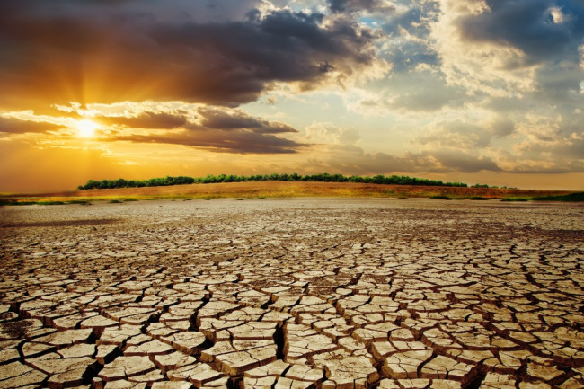
Hypothesis:
If a given area has a higher income, then more grocers are to be found in said area.
Leads to

Slide 3
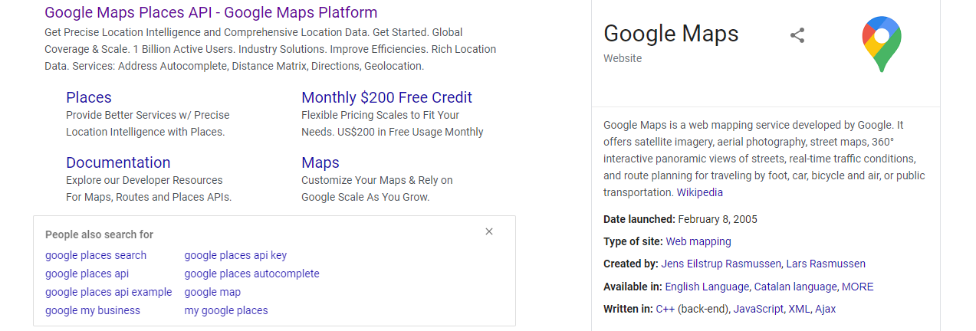
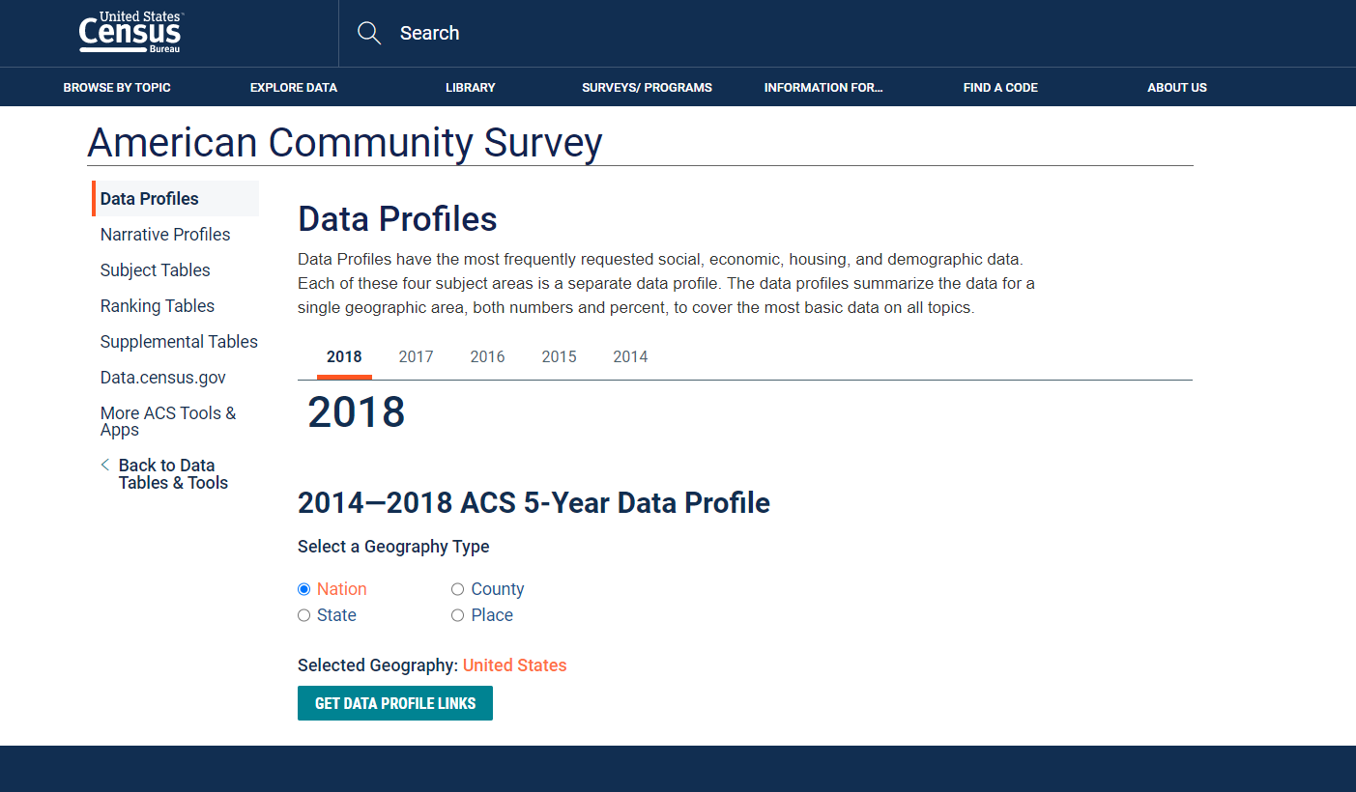
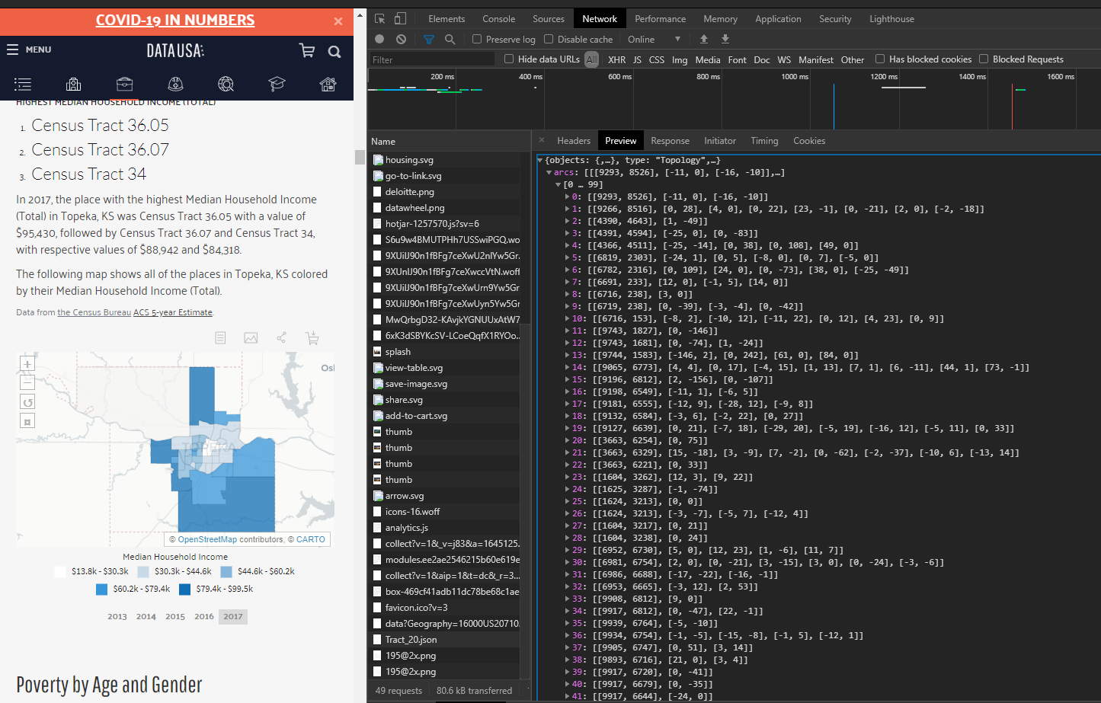
Data Round Up
Google Places Api
Census Bureau American Community Survey
Ben did it so it must be alright
https://www.census.gov/acs/www/data/data-tables-and-tools/data-profiles/
https://datausa.io/profile/geo/topeka-ks/

Slide 4
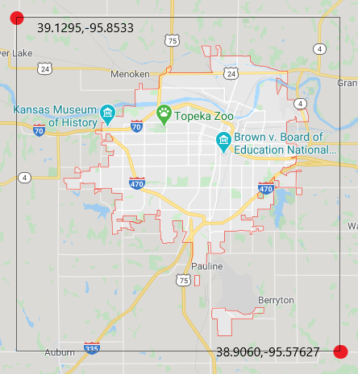
The Area

Slide 5
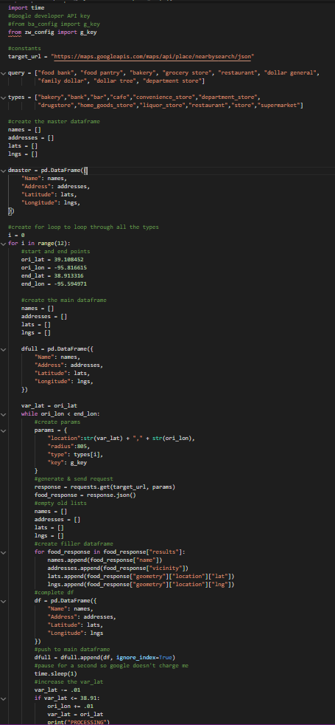

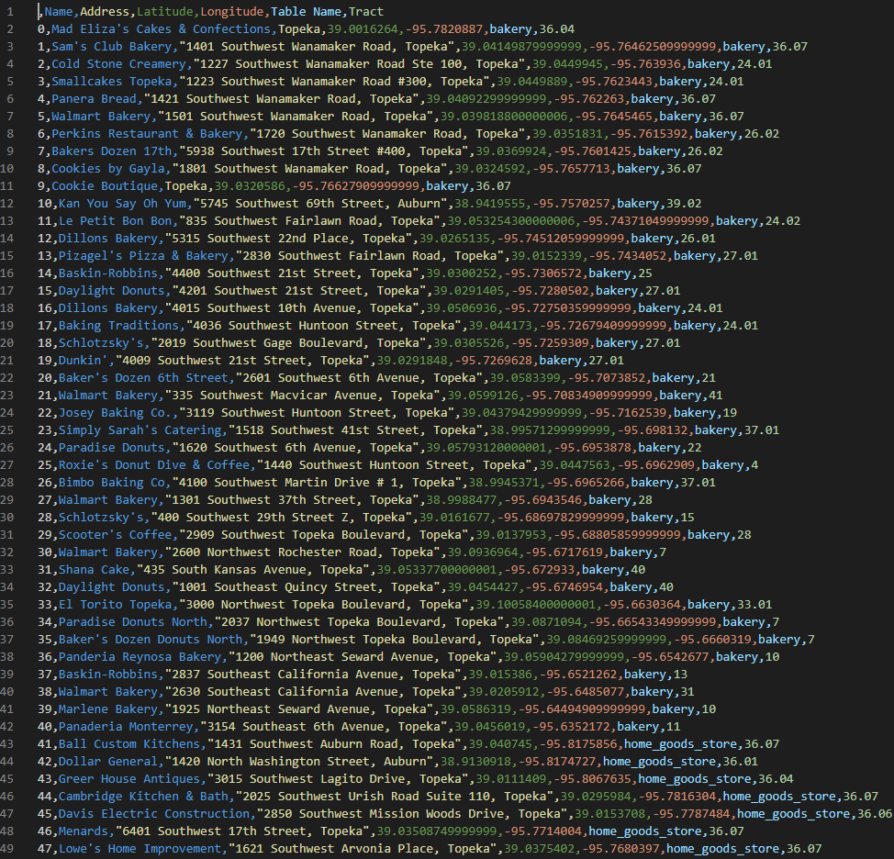
The Data
​The Master
Pulled data from google places Api
The Code
places_scrape.py
clean.py
Master_maker.py
The Product

Slide 6
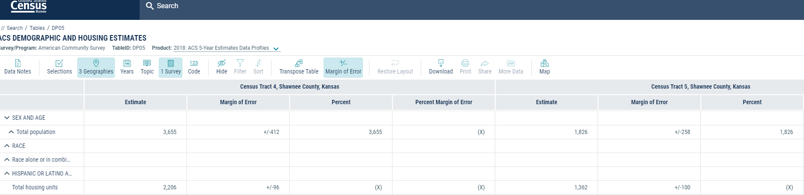
More Data
We also pulled Census Data for the population and housing
https://data.census.gov/cedsci/table?d=ACS%205-Year%20Estimates%20Data%20Profiles&table=DP05&tid=ACSDP5Y2018.DP05&g=0400000US20_1600000US2071000_0500000US20177.140000&hidePreview=true

Slide 7
Tableau stuff
Describe the viz
Cool Viz

Slide 8
Machine Learning
What it do?
Neat screen Cap

Slide 9
Conclusion
Words

Slide 10
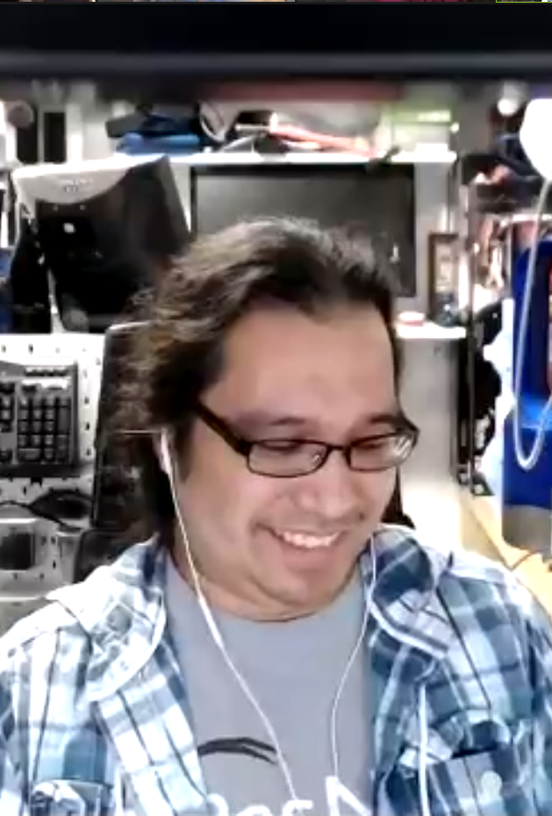
Thanks to the TA'S and to Ben for all the help and support
z

